Slide 1
Can We Learn to Leave in Peace?
VICTORY, 70

Slide 2
Где бы ни находился советский человек – на фронте, в тылу страны, в тылу врага, в фашистких лагерях – всюду и везде он делал все от него зависящее, чтобы приблизть час победы.
Г.Н. Жуков

Slide 3
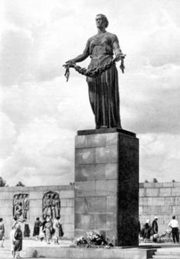

Slide 4
Listen to the story of veteran and answer the questions
What was Galina’s profession (education)?
How old was she?
Why did she get marriage?

Slide 5
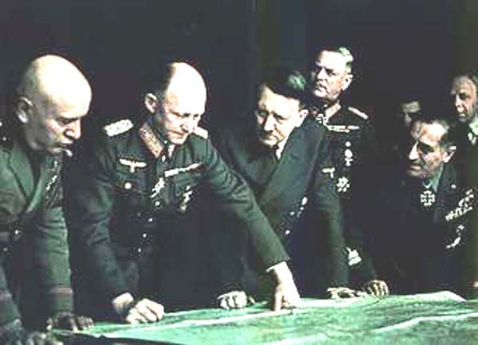
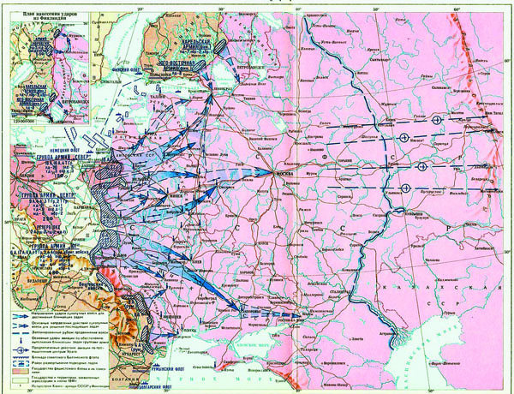
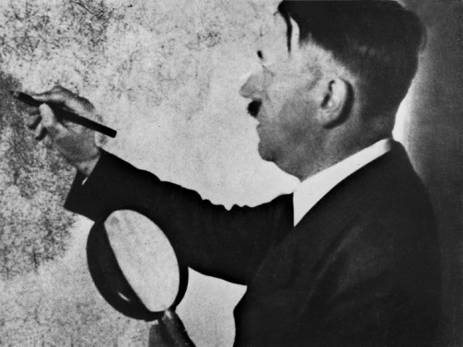
«Barbarossa Fall»

Slide 6
The Main Steps of Great Patriotic War
the Event | date
Beginning of the war | 22.06.1941
Moscow battle | December, 1941
Stalingrad battle | July – February, 1942 – 1943
Battle at the Arc of Kursk | July – August, 1943
Liberation of Leningrad, Odessa, Kerch, the Crimea | 1944
The End of the GPW | 9 May 1945

Slide 7
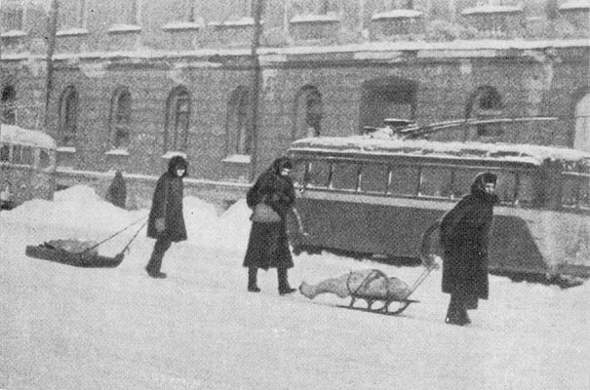
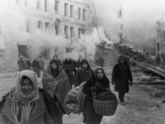

Slide 8
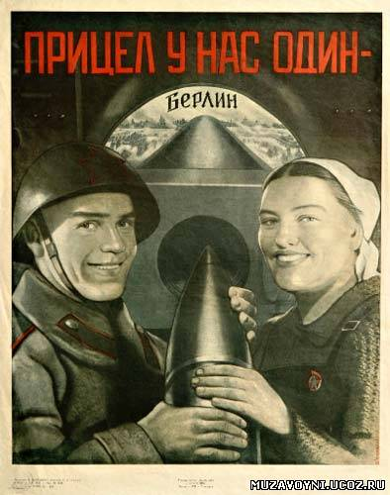
It was a great effort of all our country.
There were a lot of heroes (about 12000 become the titles the Hero of SU), a great number of brave actions.

Slide 9
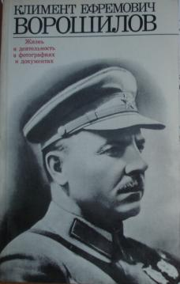
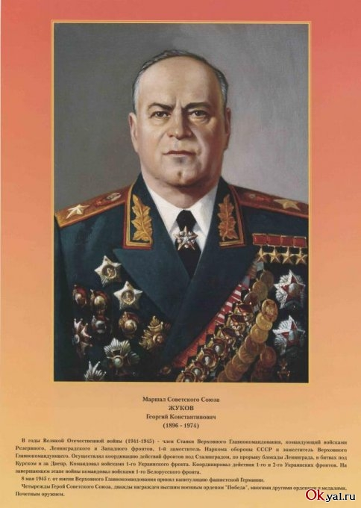
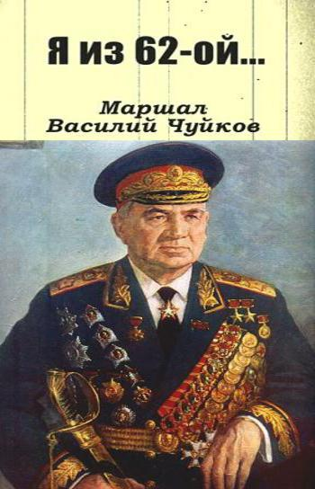

Slide 10
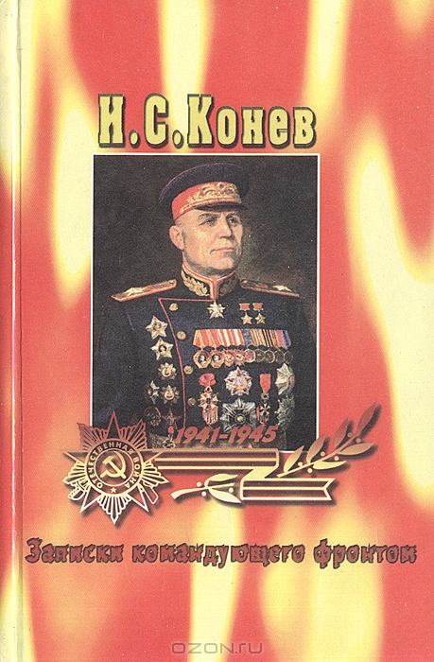
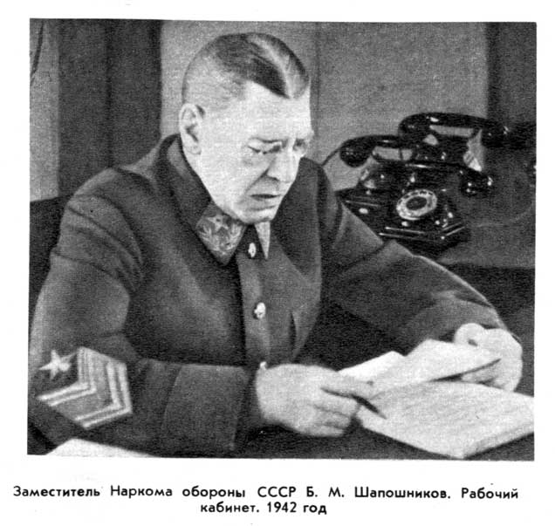
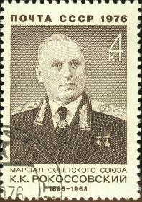

Slide 11
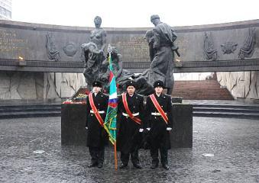

Slide 12
Questions
When was undersigned the Act?
What should Germany do according to the Act?
What languages was the Act drawn up?

Slide 13
ACT OF MILITARY SURRENDER
We the undersigned, acting by authority of the German High Command, hereby surrender unconditionally to the Supreme Commander, Allied Expeditionary Force and simultaneously to the Supreme High Command of the Red Army all forces on land, at sea, and in the air who are at this date under German control.
The German High Command will at once issue order to all German military, naval and air authorities and to all forces under German control to cease active operations at 2301 hours Central European time on 8th May 1945, to remain in all positions occupied at that time and to disarm completely, handing over their weapons and equipment to the local allied commanders or officers designated by Representatives of the Allied Supreme Commands. No ship, vessel, or aircraft is to be scuttled, or any damage done to their hull, machinery or equipment, and also to machines of all kinds, armament, apparatus, and all the technical means of prosecution of war in general.
The German High Command will at once issue to the appropriate commanders, and ensure the carrying out of any further orders issued by the Supreme Commander, Allied Expeditionary Force and by the Supreme Command of the Red Army.
This act of military surrender is without prejudice to, and will be superseded by any general instrument of surrender imposed by, or on behalf of the United Nations and applicable to GERMANY and the German armed forces as a whole.
In the event of the German High Command or any of the forces under their control failing to act in accordance with this Act of Surrender, the Supreme Commander, Allied Expeditionary Force and the Supreme High Command of the Red Army will take such punitive or other action as they deem appropriate.
This Act is drawn up in the English, Russian and German languages. The English and Russian are the only authentic texts.
Signed at Berlin on the 8 day of May, 1945
Von Friedeburg
Keitel
Stumpff
On behalf of the German High Command

Slide 14
Exercise 1
Connect the event and the date
Beginning of the Great Patriotic War | 9.05.1945
Liberation of major cities of the Soviet Union | 1944
Moscow battle | Summer, 1943
Battle of the Arc of Kursk | 22.06.1941
The end of Great Patriotic War | December, 1941

Slide 15
Exercise 2 Choose the names of leaders in GPW
A. Pushkin, G. Zhukov, K. Rokossovsky, M. Zvetaeva, S. Timoshenko, I. Panfilov, V. Klochkov, V. Fet, S. Zdorovtsov, V. Molotov, U, Smirnov, V. Kuprin, L. Tolstoy, Z. N.F. Vatutin.

Slide 16
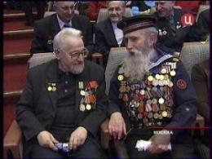
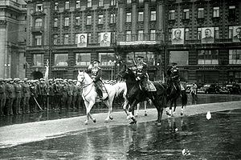

Slide 17
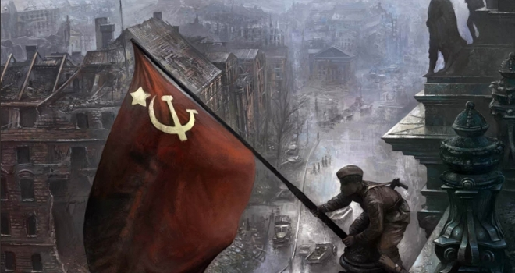

Slide 18
Thank you!

